Slide 1
Program and data

Slide 2
Data type
Different types of data are represented in different ways inside a computer and need varying amounts of memoryto store them. They also have different operations that can be performed upon them. All values that belong to the same data type will be represented in the same way.

Slide 3
Data type
Data type | example | size
Integer (whole number) | 4, 27, 65535 | 1 to 8 bytes
Floating point (decimal number) | 4.2, 27.4, 5.63 | 4 to 8 bytes
Character | a, F, 3, $, £, # | 1 byte
String | abc, hello world | Limited to the amount that can be stored in main memory
Boolean | true or false | 1 bit
Date/Time | 09/04/15
image | .bmp,.jpg | depend upon the image

Slide 4
Constant and variable
Data value can be constant or variable; when a program is run ,the data values are held in memory whilst they are being worked on.
Constant: e.g.
the unit of gravity
the number of lives available for the player
the amount of time allowed for a level in a game

Slide 5
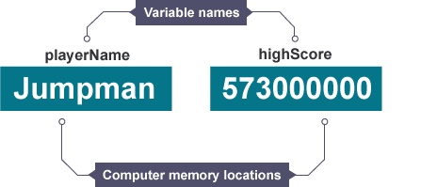
Variable
Variables are data values that can change when the user is asked a question, for example, their age. Variables may change during program execution.
A variable is a memory location.

Slide 6
Array
A variable is a memory location that can store a value. It can be thought of as a box in which values are stored. The value held in the box can change, or vary. But each variable can only hold one item of data.
E.g.
Score-1
Score-2
Score-3
Instead of having 3 variables we have score (10)

Slide 7
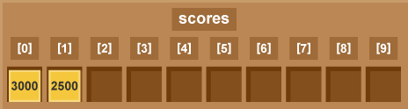
Arrays
Score [0] = 3000
Language like BASIC and java allow arrays
Python only allows lists

